Slide 1
2025 Duke Datafest
Team Name: Ungroup()
Team Members: Kripa Kasabwala, Vraj Hingoo, Jiya Gupta, Pranav Mucharla, Marianne Baquero

Slide 2
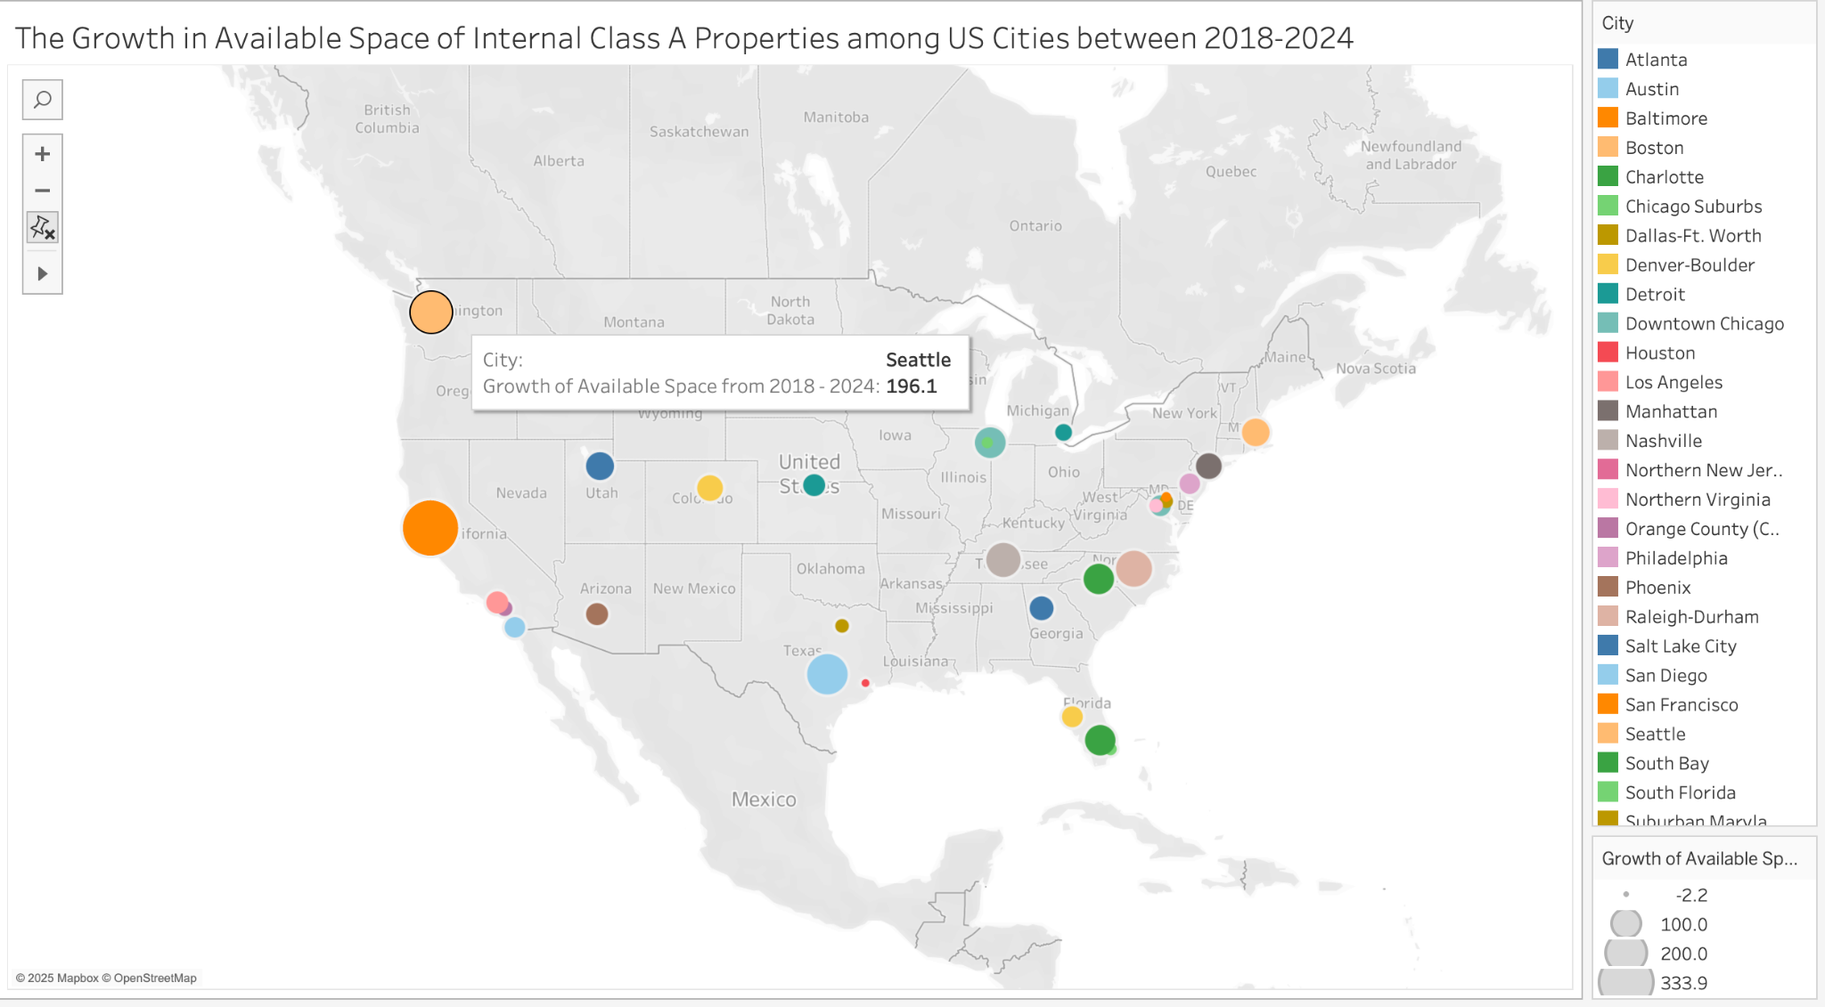
UWash
UChicago
UMich
BU,
BC,
MIT
RU
CU Boulder
UMD
UCSB, UCSC, UCD, and UCB
UNC,
Duke
UCLA
GT
Univ. of AZ
UCSD
UT-Austin
Univ of Miami
UF
“42% of hiring managers are more likely to hire public university grads than they were five years ago.” - Forbes

Slide 3
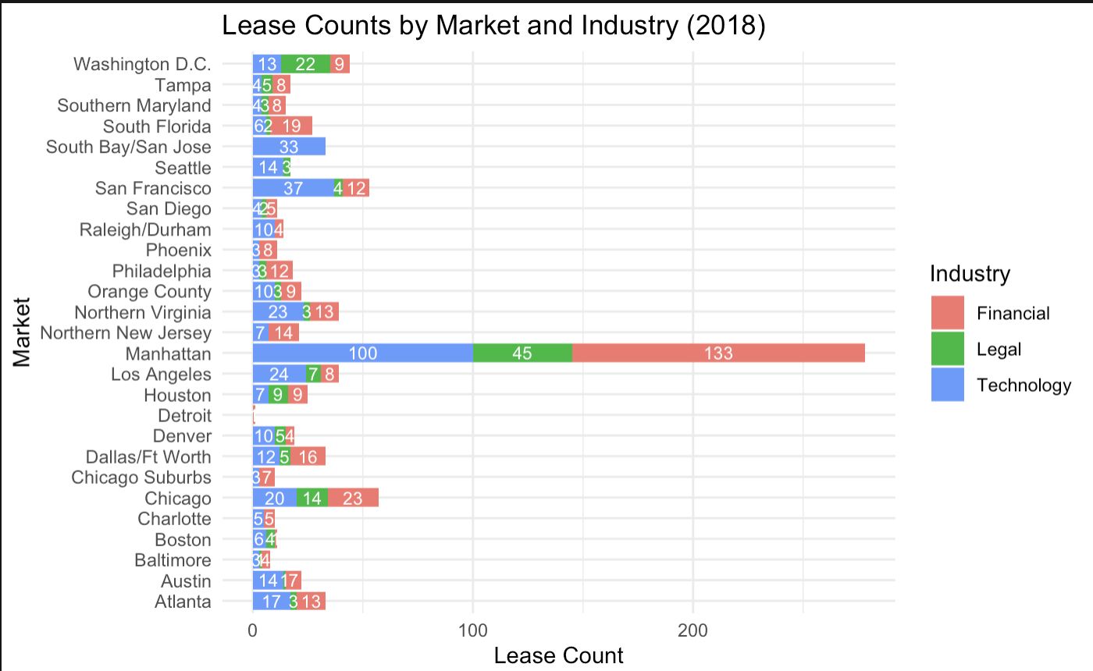
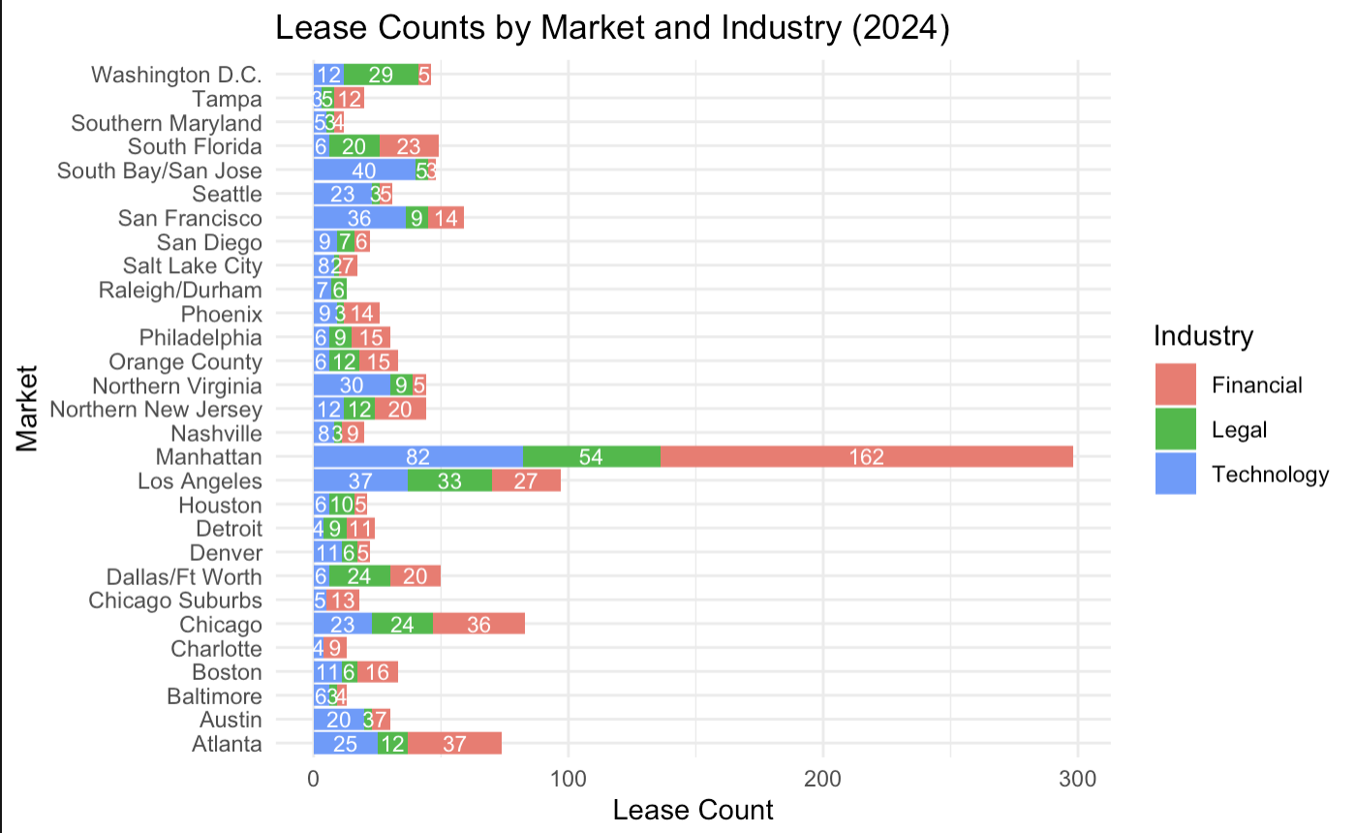
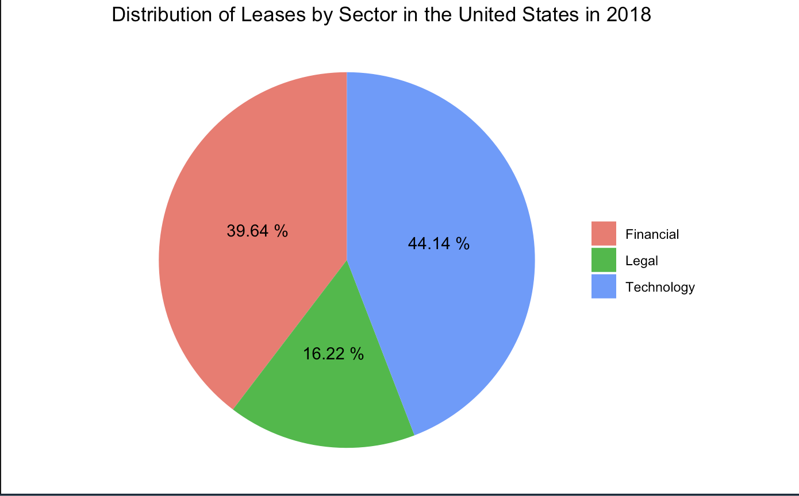
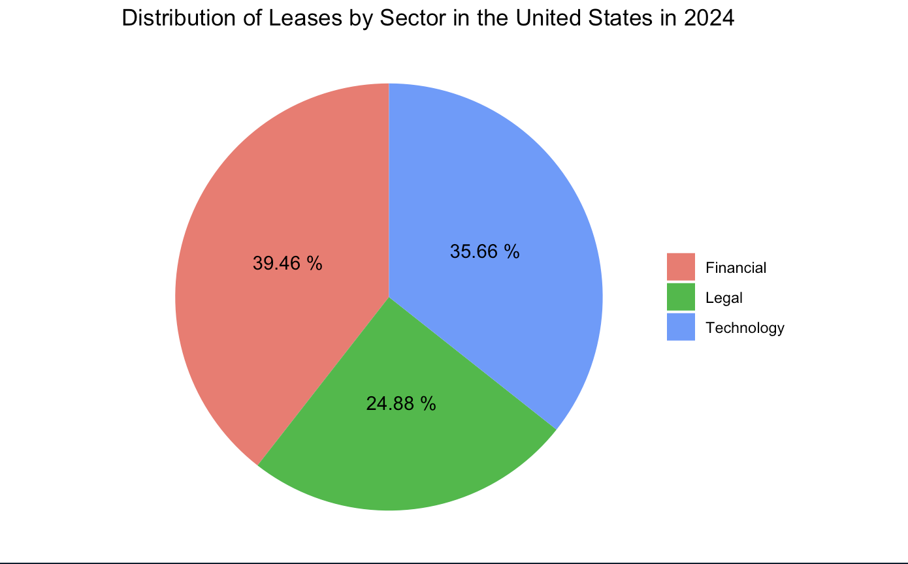
New Markets!
New Markets
-0.18%
Financial
-8.48%
Technology
+8.66%
Legal

Slide 4
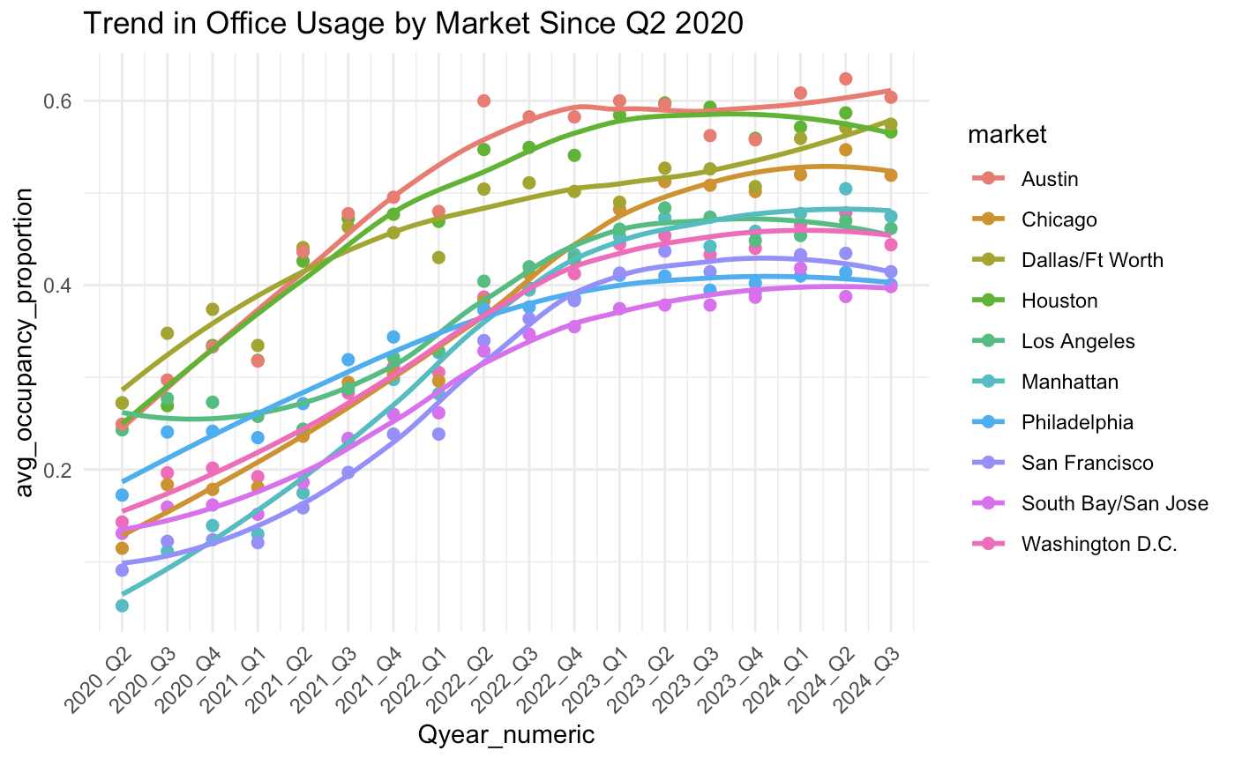
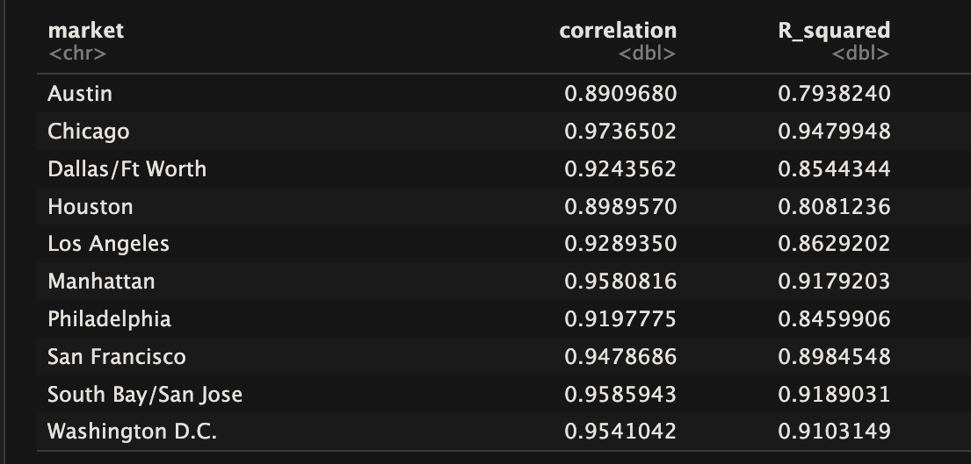
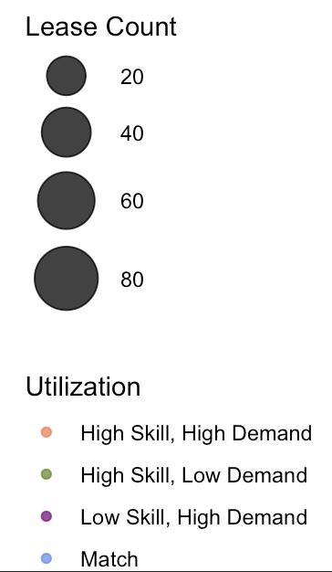
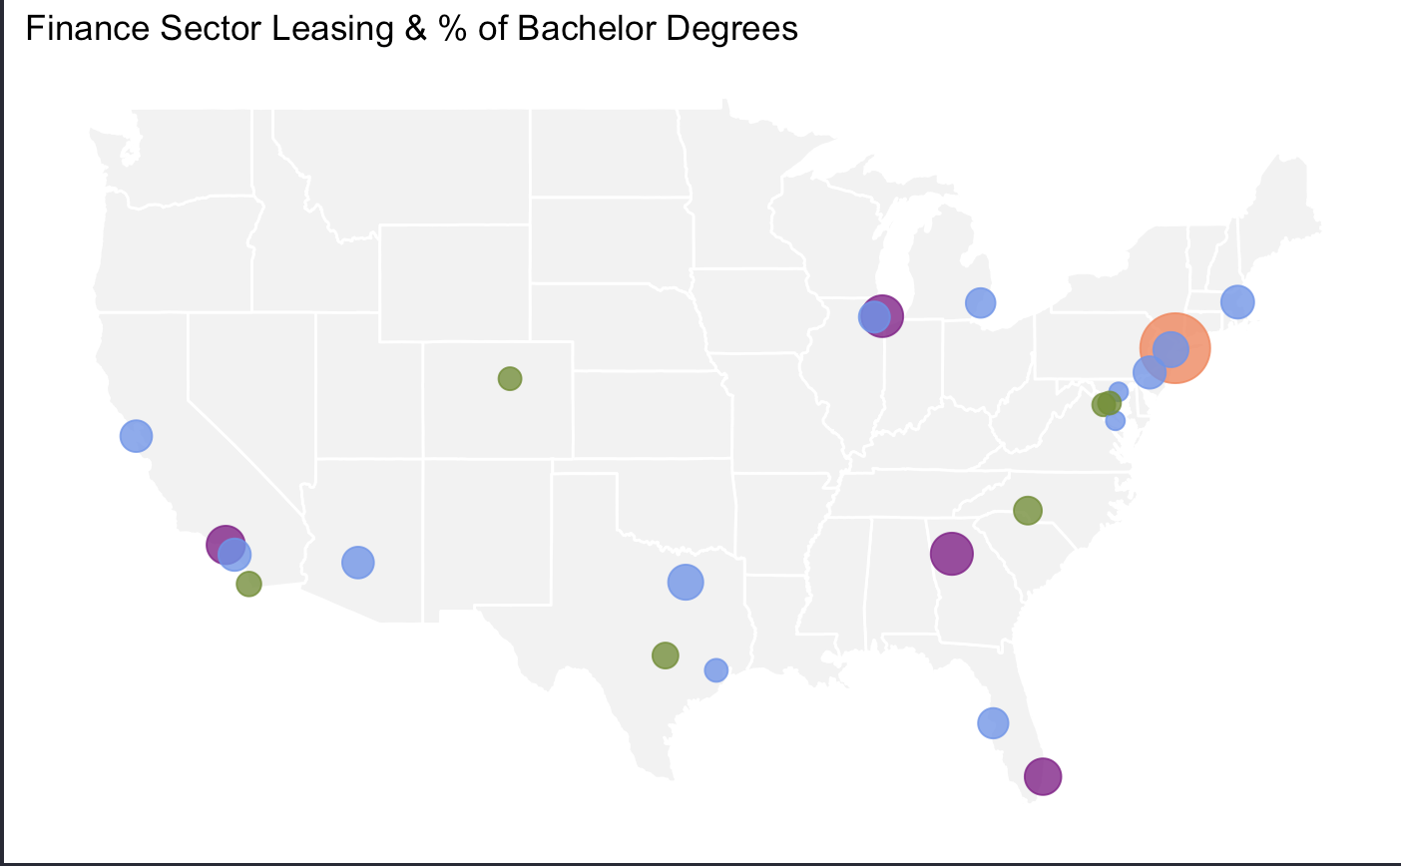
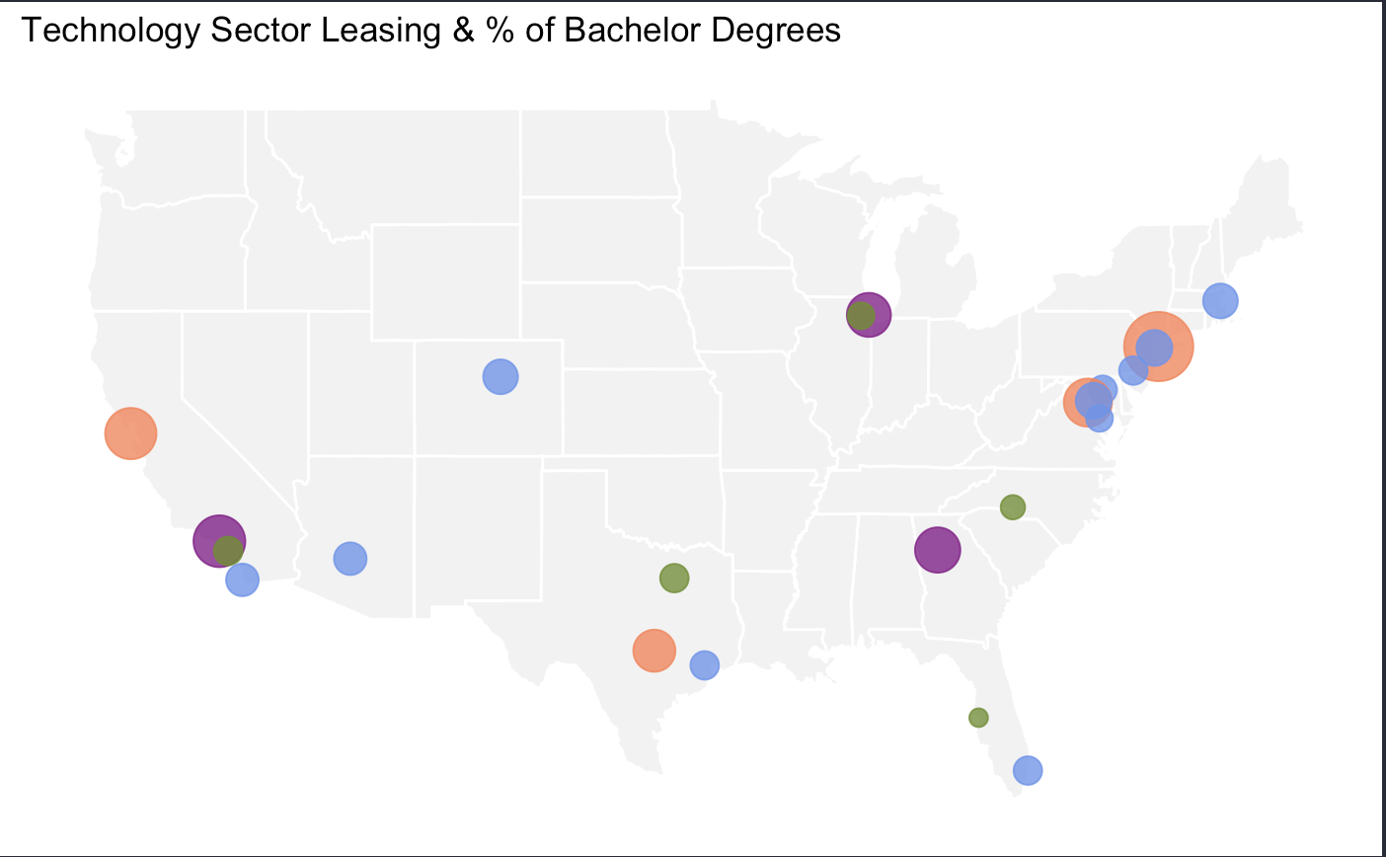
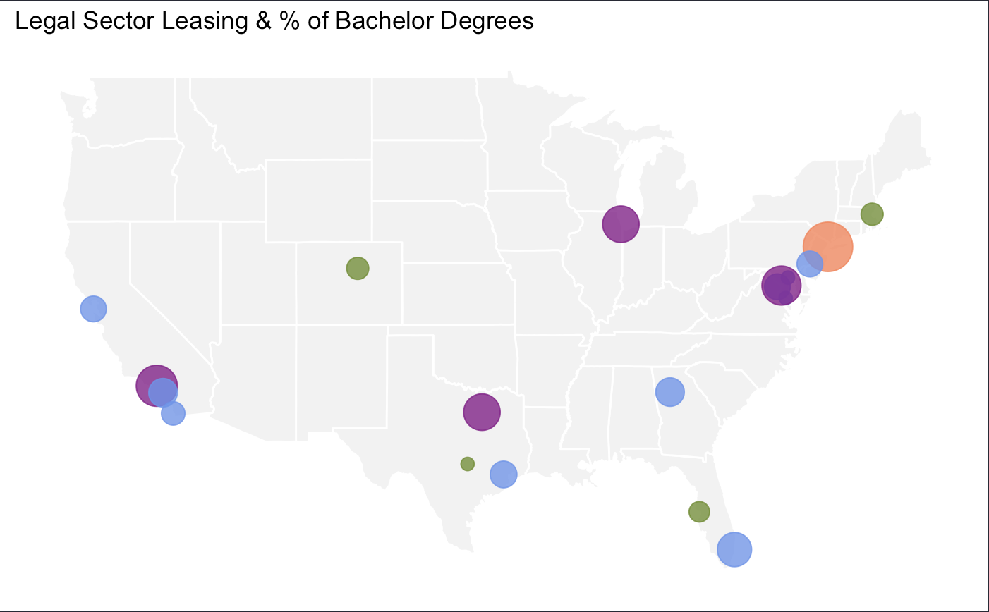
2024 Lease Count Compared with % Pop. Bachelors Degrees

